Slide 1
Hadoop (Apache Hadoop)

Slide 2
What is Hadoop?
Hadoop is an open-source software framework that is used for storing and processing large amounts of data in a distributed computing environment.
It is designed to handle big data and is based on the MapReduce programming model, which allows for the parallel processing of large datasets.
Its framework is based on Java programming with some native code in C and shell scripts.

Slide 3
What is Hadoop?
Hadoop is commonly used in big data scenarios such as data warehousing, business intelligence, and machine learning. It’s also used for data processing, data analysis, and data mining. It enables the distributed processing of large data sets across clusters of computers using a simple programming model.

Slide 4
Two Main Components
HDFS and MapReduce
HDFS (Hadoop Distributed File System): This is the storage component of Hadoop, which allows for the storage of large amounts of data across multiple machines. It is designed to work with commodity hardware, which makes it cost-effective.
MapReduce: (Processing Unit of Hadoop) If a query is requested then MapReduce will process it according to key value pairs and find solution from multiple Data nodes

Slide 5
HDFS client
Name Node
Data node
Data node
Data node
Data node
Data node
Local Disk
Local Disk
Local Disk
Local Disk
Local Disk

Slide 6
Provides Rack Awareness: That a single data node should have different type of data in it like A,B,C
Copy of A on average 3 copies are saved on different Data nodes to sure Fault Tolerance.

Slide 7
Functions of NameNode
It records the Meta Data of all the files stored in the cluster e.g Location of blocks stored, size of the files, permissions, hierarchy.
Two files associated with meta data:
FSImage:it contains the complete state of the file system namespace since the start of the namenode.
EditLogs:it contains all the recent modifications made to the file system with respect to the most recent FSImage.
It regularly receives a heartbeat and a block reportfrom all the data nodes in the cluster to ensure that the data nodes are live.

Slide 8
MapReduce
MapReduce performs the processing of large data set in a distributed and parallel manner.
Two distinct tasks: Map and Reduce
Two essential components: Job Tracker and Task Tracker
Job Tracker: Resource Management, Scheduling, Monitioring

Slide 9
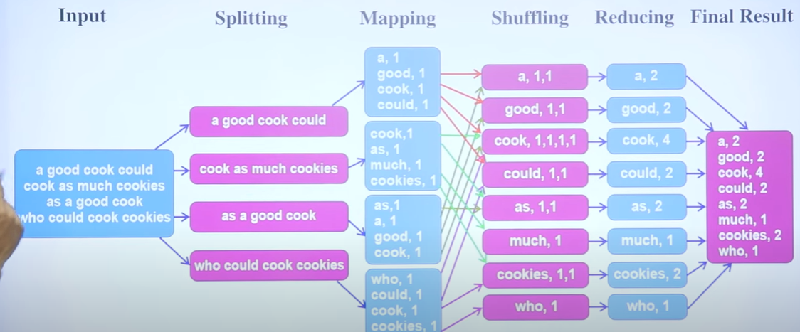
MapReduce working

Slide 10
Other Components
YARN (Yet Another Resource Negotiator): This is the resource management component of Hadoop, which manages the allocation of resources (such as CPU and memory) for processing the data stored in HDFS.
Hadoop also includes several additional modules that provide additional functionality, such as Hive (a SQL-like query language), Pig (a high-level platform for creating MapReduce programs), and HBase (a non-relational, distributed database).

Slide 11
Features of Hadoop
Distributed Storage: Hadoop stores large data sets across multiple machines, allowing for the storage and processing of extremely large amounts of data.
Scalability: Hadoop can scale from a single server to thousands of machines, making it easy to add more capacity as needed.
Fault-Tolerance: Hadoop is designed to be highly fault-tolerant, meaning it can continue to operate even in the presence of hardware failures.
Data locality: Hadoop provides data locality feature, where the data is stored on the same node where it will be processed, this feature helps to reduce the network traffic and improve the performance

Slide 12
Features of Hadoop
High Availability: Hadoop provides High Availability feature, which helps to make sure that the data is always available and is not lost.
Flexible Data Processing: Hadoop’s MapReduce programming model allows for the processing of data in a distributed fashion, making it easy to implement a wide variety of data processing tasks.
Data Integrity: Hadoop provides built-in checksum feature, which helps to ensure that the data stored is consistent and correct.
Data Replication: Hadoop provides data replication feature, which helps to replicate the data across the cluster for fault tolerance.

Slide 13
Features of Hadoop
Data Compression: Hadoop provides built-in data compression feature, which helps to reduce the storage space and improve the performance.
YARN: A resource management platform that allows multiple data processing engines like real-time streaming, batch processing, and interactive SQL, to run and process data stored in HDFS.

Slide 14
Some common frameworks of Hadoop
Hive- It uses HiveQl for data structuring and for writing complicated MapReduce in HDFS.
Drill- It consists of user-defined functions and is used for data exploration.
Storm- It allows real-time processing and streaming of data.
Spark- It contains a Machine Learning Library(MLlib) for providing enhanced machine learning and you can seamlessly integrate data processing tasks with machine learning tasks within the same framework. It also supports Java, Python, and Scala.
Pig- It has Pig Latin, a SQL-Like language and performs data transformation of unstructured data.
Tez- It reduces the complexities of Hive and Pig and helps in the running of their codes faster.

Slide 15
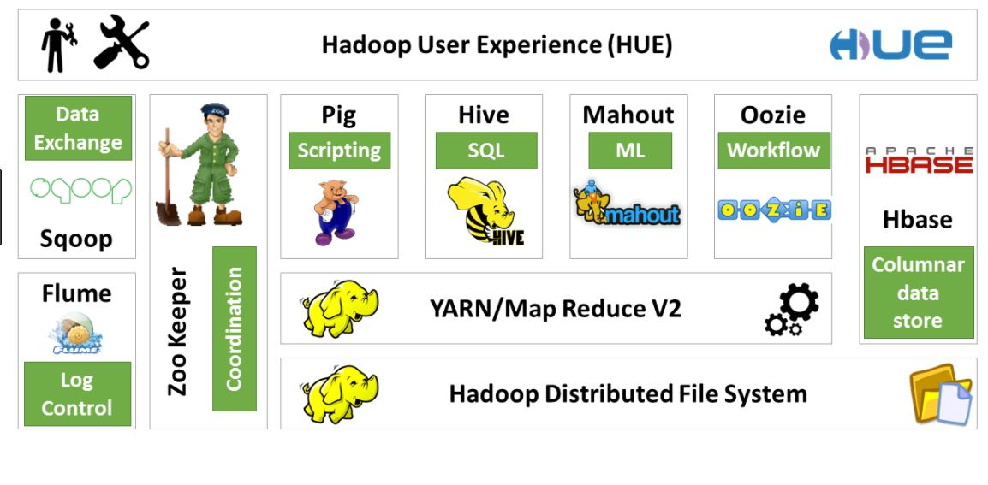

Slide 16
Applications of Hadoop
Yahoo was among the first companies to embrace Hadoop. Since then, several top businesses, including Facebook, Twitter, and Adobe, have implemented this in their architecture to benefit their organization.
In Banking and Securities, Big Data can monitor fraudulent activities, give early warnings, detect card fraud, audit trails, credit risk reporting, and manage customer data analytics to ease security issues in the financial sector.
The Food and Drug Administration is now utilizing Big Data to check and detect patterns between food-related illnesses and diseases for user behavior and response to multiple variables.
In the Transportation sector, Hadoop has been implemented in managing traffic, creating intelligent transport systems, route planning, and avoiding congestion. Especially for the logistics department, Big Data can be used to track shipments, travel moments, and further, save fuel by adopting best practices and instructions to vehicles.

Slide 17
Installation of hadoop
Pre-requisite
A virtual machine such as Oracle Virtual Box or VMWare
RAM of 12+ GB. That is 4+ GB for the operating system and 8+ GB for Cloudera
80GB hard disk

Slide 18
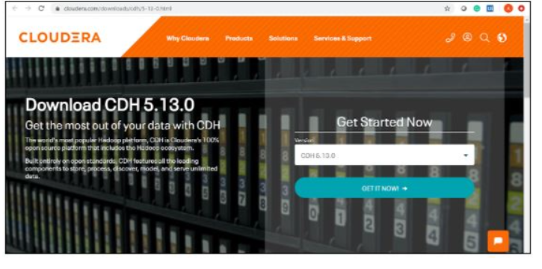
Installation of hadoop
To download the VM, search for https://www.cloudera.com/downloads.html
and select the appropriate version of CDH that you require.

Slide 19
Installation of hadoop
Click on the ‘GET IT NOW’ button, and it will prompt you to fill in your details.
Once the file is downloaded, go to the download folder and unzip these files. It can then be used to set up a single node Cloudera cluster.
Shown below are the two virtual images of Cloudera QuickStart VM.

Slide 20
Cloudera QuickStart VM Installation
Before setting up the Cloudera Virtual Machine, you would need to have a virtual machine such as VMware or Oracle VirtualBox on your system.
In this case, we are using Oracle VirtualBox to set up the Cloudera QuickStart VM.
In order to download and install the Oracle VirtualBox on your operating system, click on the following link: Oracle VirtualBox.
To set up the Cloudera QuickStart VM in your Oracle VirtualBox Manager, click on ‘File’ and then select ‘Import Appliance’.

Slide 21
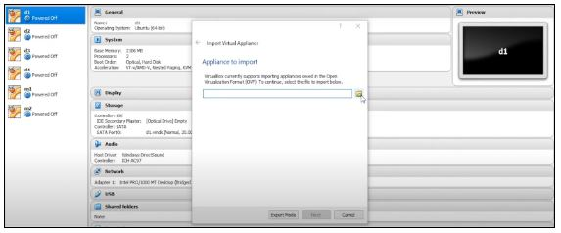
Cloudera QuickStart VM Installation
Choose the QuickStart VM image by looking into your downloads. Click on ‘Open’ and then ‘Next’. Now you can see the specifications, then click on ‘Import’. This will start importing the virtual disk image .vmdk file into your VM box.

Slide 22
Cloudera QuickStart VM Installation
Once this is done, we have to change the specifications of the machines to use. Here, we are giving 2 CPU cores and 5GB RAM. Wait for a while, as the importing finishes. The next step is to go ahead and set up a Cloudera QuickStart VM for practice. Once the importing is complete, you can see the Cloudera QuickStart VM on the left side panel.
Now, to give more RAM and CPU cores, click on ‘Settings’, followed by ‘System’, and increase the RAM to 5GB. Click on the processor and assign 2 CPU cores. Subsequently, select ‘Network’. The Adapter 1 settings should be NAT by default. Click on ‘OK’ next.
Now you are required to start the machine, so that it uses 2 CPU cores, 5GB RAM, and brings up the Cloudera QuickStart VM.
The next step will be going ahead and starting the machine by clicking the ‘Start’ symbol on top.

Slide 23
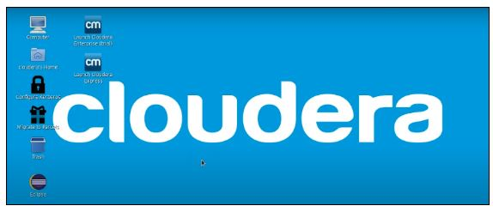
Cloudera QuickStart VM Installation
Once your machine comes on, it will look like this:

Slide 24
Cloudera QuickStart VM Installation
Next, we have to follow a few steps to gain admin console access. You need to click on the terminal present on top of the desktop screen, and type in the following:
hostname # This shows the hostname which will be quickstart.cloudera
hdfs dfs -ls / # Checks if you have access and if your cluster is working. It displays what exists on your HDFS location by default
service cloudera-scm-server status # Tells what command you have to type to use cloudera express free
su - #Login as root
service cloudera-scm-server status # The password for root is cloudera

Slide 25
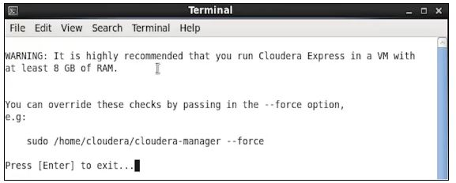
Cloudera QuickStart VM Installation
Once you click on the express icon, a screen will appear with the following command:

Slide 26
Cloudera QuickStart VM Installation
You are required to copy the command, and run it on a separate terminal. Hence, open a new terminal, and use the below command to close the Cloudera based services. It will restart the services, after which you can access your admin console.
Now that our deployment has been configured, client configurations have also been deployed. Additionally, it has restarted the Cloudera Management Service, which gives access to the Cloudera QuickStart admin console with the help of a username and password.
Go on and open up the browser and change the port number to 7180.
You can log in to the Cloudera Manager by providing your username and password.

Slide 27
Cloudera QuickStart VM Installation
Since Cloudera is CPU and memory intensive, it could slow down if you haven’t assigned enough RAM to the Cloudera cluster. So, it’s always recommended to stop or delete the services that you don’t need.
Next, click on the drill-down button associated with each service and select delete to remove it.
Before deleting any service, you must remove all the dependencies for that particular service. You can add services to your cluster at any point in time when you need it. You can also fix different configuration issues thereupon.
In Cloudera Manager, you can fix the health issues or configuration issues within your cluster.

Slide 28
Cloudera QuickStart VM Installation
You can go ahead and restart the services now. It will ensure that the cluster becomes accessible either by Hue as a web interface or Cloudera QuickStart Terminal, where you can write your commands.
You can switch to an HDFS user, which is the admin user. This usually does not have a password unless you have set it. Now, you can type any HDFS command in the terminal, which will give the output.

